Slide 1






The War Lords Trilogy
Chapter 3: The Fellowship
LRT214
E1200-AP
LGS105

Slide 2

Appendix 1: Physical Network Diagram
ISP
LGS105
WAN
WAN
WAN
LRT214
LRT214
LRT214
LAN
LAN
LAN
E1200-AP
E1200-AP
E1200-AP
SSID | GRP10
IP address range: | 192.168.10.100 to 192.168.10.150
Subnet Mask: | 255.255.255.0
Router IP address | 192.168.10.254 (pre-configured)
SSID | GRP20
IP address range: | 192.168.20.100 to 192.168.20.150
Subnet Mask: | 255.255.255.0
Router IP address | 192.168.20.254 (pre-configured)
SSID | GRP30
IP address range: | 192.168.30.100 to 192.168.30.150
Subnet Mask: | 255.255.255.0
Router IP address | 192.168.30.254 (pre-configured)

Slide 3
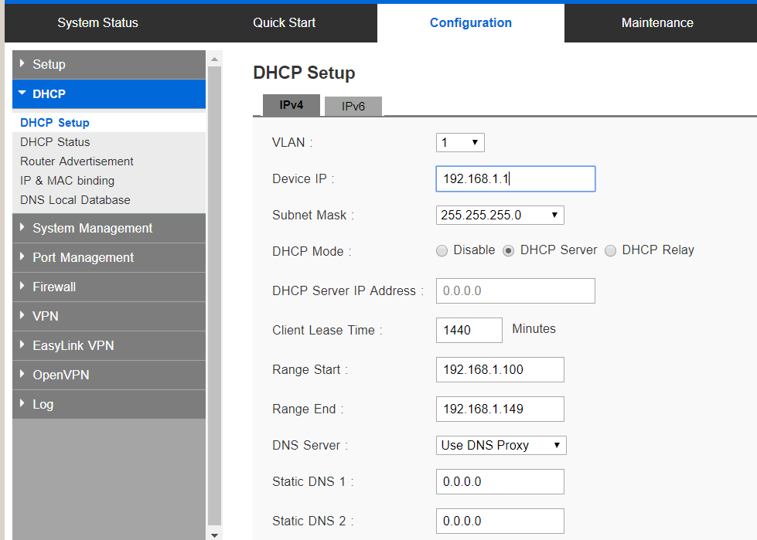
Lab 2: DHCP and Network Routing
The overall objective of this lab is to apply the concepts of IP addressing and routing to configure an Intranet.
Learning Objectives: | Configure the DHCP service on a router to provide IP addresses on a LAN Setup and configure routing Apply static routes to provide connectivity on an Intranet
Resources: | Network routers (LRT214) Wireless Access point (E1200AP) Switch (LGS105)
Part 1 : Configure DHCP
To avoid the trouble of having to manually configure IP addresses, the DHCP service on a router allow IP addresses to be issued automatically to devices on the network.
 | Tasks (Note X refers to your group number) | References
1 2 3 4 6 7 | Wire up your wireless AP(E1200-AP) and router(LRT214) based on Appendix 1. Connect to any of the LAN ports on the router and AP. Select 1 PC in your group to perform this task. Configure a static IP address, 192.168.X.10 /255.255.255.0 on 1 PC so that it could access the router’s web admin interface. Connect to your group’s SSID. Open a web browser and connect to your group’s router using its IP address. Login using id admin and password admin123. (Refer to Appendix 1) [ if you get a warning message , just click advance and proceed] On the web interface, access the Configuration tab and DHCP. Enable DHCP serve mode. Configure the Range Start and End IP addresses based on Appendix 1. Select Use DNS Proxy. Save the configuration. For the rest of the PCs in your group, configure them to get IP addresses automatically from the DHCP service. Verify that your PC is getting a correct IP address using ipconfig/ifconfig command. Test connectivity using the ping command (As in previous lab) All the PCs in the group can now use their web browser to connect and login to their group’s router web interface. | Appendix 1 Groups

Slide 4
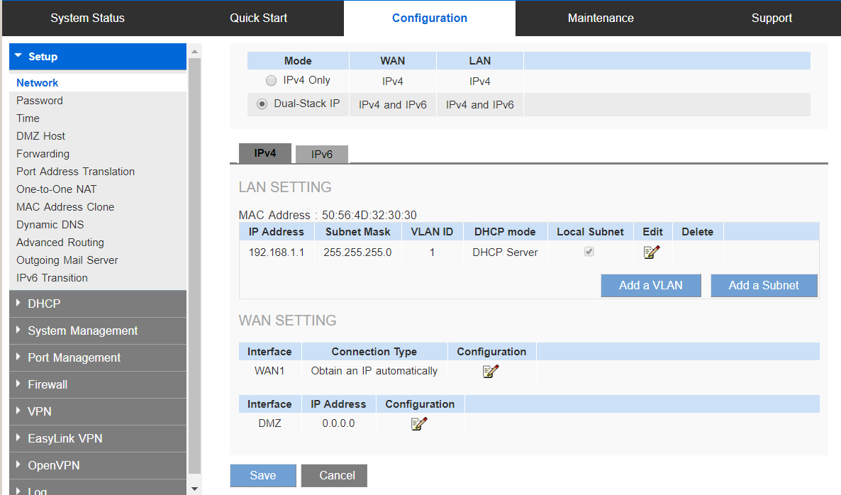
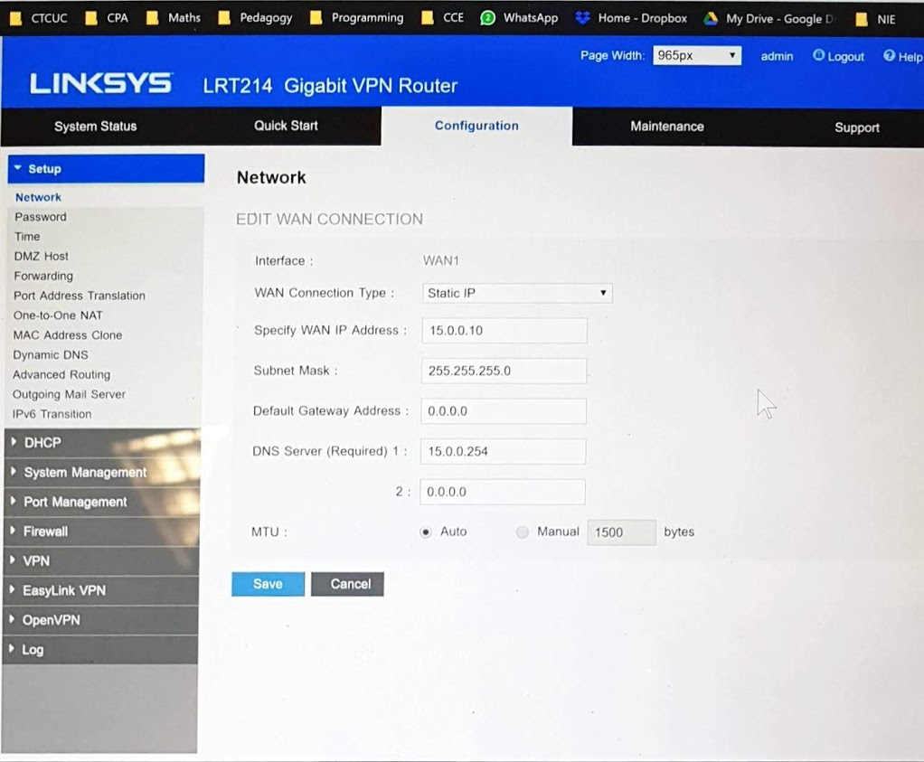
Part 2 : Connecting to the ISP Network
A ISP network is a backbone which has access to other networks
To provide routing, a router will need to configure 2 network interface, a LAN interface to connect to a LAN and a WAN interface to connect to the ISP.
 | Tasks | References
1 2 3 | Connect a cable from the router’s WAN interface to any ports on the ISP switch according to Appendix 1. On the router’s web interface, access the Configuration tab and Setup Network. - Click on the WAN1 interface configuration to edit the WAN Interface. Select Static IP for the WAN Connection type. Enter the IP address /Subnet mask assigned to your group Enter the default gateway address as 15.0.0.253 Enter the DNS server address as 15.0.0.253 Save Configuration. | Appendix 2

Slide 5
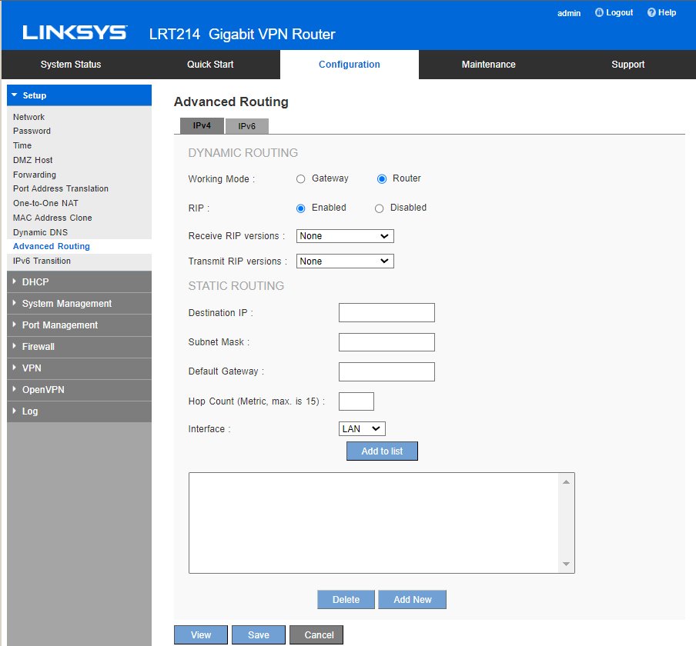
Part 3: Configure static routes
A router uses its routing table to determine which interface and destination router to forward packets to
 | Tasks | References
1 2 3 | Select Advance Routing Enable Router Enable RIPv1 and RIPv2 for both Transmit and Receive | Appendix 2

Slide 6
Appendix 1: Physical Network Diagram
ISP
LGS105
WAN
WAN
WAN
LRT214
LRT214
LRT214
LAN
LAN
LAN
E1200-AP
E1200-AP
E1200-AP
SSID | GRP10
IP address range: | 192.168.10.100 to 192.168.10.150
Subnet Mask: | 255.255.255.0
Router IP address | 192.168.10.254 (pre-configured)
SSID | GRP20
IP address range: | 192.168.20.100 to 192.168.20.150
Subnet Mask: | 255.255.255.0
Router IP address | 192.168.20.254 (pre-configured)
SSID | GRP30
IP address range: | 192.168.30.100 to 192.168.30.150
Subnet Mask: | 255.255.255.0
Router IP address | 192.168.30.254 (pre-configured)

Slide 7
Appendix 2: Logical Network Diagram
115.0.0.0/
255.255.255.0
15.0.0.10
255.255.255.0
WAN I/F
WAN I/F
192.168.30.254
255.255.255.0
192.168.10.254
255.255.255.0
15.0.0.20
255.255.255.0
WAN I/F
15.0.0.30
255.255.255.0
LAN I/F
LAN I/F
192.168.10.0/
255.2255.255.0
192.168.20.254
255.255.255.0
LAN I/F
192.168.30.0/
255.255.255.0
192.168.20.0/
255.255.255.0

